Slide 2



Slide 3
Unreal Engine Mass A brief technical overview.
Gary Reif

Slide 4
Who am I?
Name: Gary Reif
Email: Gary.Reif@Zapper.Games
Currently: Gameplay Programmer – Zapper Games
Previously: Programmer – Puny Human

Slide 5
Who am I?
Name: Gary Reif
Email: Gary.Reif@Zapper.Games
Currently: Gameplay Programmer – Zapper Games
Previously: Programmer – Puny Human
Why am I here?

Slide 6
Who am I?
Name: Gary Reif
Email: Gary.Reif@Zapper.Games
Currently: Gameplay Programmer – Zapper Games
Previously: Programmer – Puny Human
Why am I here?
Let’s Talk About Mass!

Slide 7
Who am I?
Name: Gary Reif
Email: Gary.Reif@Zapper.Games
Currently: Gameplay Programmer – Zapper Games
Previously: Programmer – Puny Human
Why am I here?
Let’s Talk About Mass!
Mass Expertise: None.

Slide 8
Who am I?
Name: Gary Reif
Email: Gary.Reif@Zapper.Games
Currently: Gameplay Programmer – Zapper Games
Previously: Programmer – Puny Human
Why am I here?
Let’s Talk About Mass!
Mass Expertise: None.
Mass Experience: A year spent the hard way.

Slide 9
Who am I?
Name: Gary Reif
Email: Gary.Reif@Zapper.Games
Currently: Gameplay Programmer – Zapper Games
Previously: Programmer – Puny Human
Why am I here?
Let’s Talk About Mass!
Mass Expertise: None. Well maybe some.
Mass Experience: A year spent the hard way.

Slide 10
Who am I?
Name: Gary Reif
Email: Gary.Reif@Zapper.Games
Currently: Gameplay Programmer – Zapper Games
Previously: Programmer – Puny Human
Why am I here?
Let’s Talk About Mass!
Mass Expertise: None. Well maybe some.
Mass Experience: A year spent the hard way.
Mass Conclusion: Maybe it could be easier?

Slide 11
What will we cover?
Mass Plugin Structure
ECS Concepts in Mass
Entities & Creation
Entity Manager and Entity Queries
Mass Command Buffer
Processors & Execution
Multithreading (automatic)
Translators (actor agents)
Observer Processors
Mass Representation (visualization)
State Tree Processor
Smart Objects
Movement Processor
Mass Navigation
Mass Replication
Mass Debugger
Bonus!

Slide 12
Resources
Official introduction & quick-start: https://dev.epicgames.com/community/learning/talks-and-demos/37Oz/large-numbers-of-entities-with-mass-in-unreal-engine-5
Official “First 60 Minutes with Mass”: https://dev.epicgames.com/community/learning/tutorials/JXMl/unreal-engine-your-first-60-minutes-with-mass
Unofficial: https://dev.epicgames.com/community/learning/tutorials/0RxY/ue5-massai-crowd-in-your-project-step-by-step-guide
Community Project: https://github.com/Megafunk/MassSample
Documentation: https://docs.unrealengine.com/5.1/en-US/mass-entity-in-unreal-engine/

Slide 13

MassEntity
Engine/Plugins/Runtime/MassEntity
Mass Archetype
Mass Commands
Entity Manager
Entity Subsystem
Mass Executor
Processing Context
Processing Phases
Mass Fragment
Mass Tag
Entity Handle
Entity View
Mass Processor
Mass Requirements
Mass Observer

Slide 14
MassEntity
MassGameplay
Engine/Plugins/Runtime/MassEntity
Engine/Plugins/Runtime/MassGameplay
Mass Archetype
Mass Commands
Entity Manager
Entity Subsystem
Mass Executor
Processing Context
Processing Phases
Mass Fragment
Mass Tag
Entity Handle
Entity View
Mass Processor
Mass Requirements
Mass Observer
Mass Actor
Mass Agent
Encoded Scalars & Vectors
Mass LOD
Mass Movement
Mass Replication
Mass Representation
Mass Signals (events)
Mass Simulation
Mass Smart Objects
Mass Spawner
Entity Config Asset

Slide 15
MassEntity
MassGameplay
Engine/Plugins/Runtime/MassEntity
Engine/Plugins/Runtime/MassGameplay
Mass Archetype
Mass Commands
Entity Manager
Entity Subsystem
Mass Executor
Processing Context
Processing Phases
Mass Fragment
Mass Tag
Entity Handle
Entity View
Mass Processor
Mass Requirements
Mass Observer
Mass Actor
Mass Agent
Encoded Scalars & Vectors
Mass LOD
Mass Movement
Mass Replication
Mass Representation
Mass Signals (events)
Mass Simulation
Mass Smart Objects
Mass Spawner
Entity Config Asset
MassAI
Engine/Plugins/AI/MassAI
Mass Behavior
Mass State Tree
Mass Smart Object
Mass AI Replication
Mass Zone Graph Navigation
Mass Navigation
Avoidance
Steering
Smooth Orientation

Slide 16
MassEntity
MassGameplay
Engine/Plugins/Runtime/MassEntity
Engine/Plugins/Runtime/MassGameplay
Mass Archetype
Mass Commands
Entity Manager
Entity Subsystem
Mass Executor
Processing Context
Processing Phases
Mass Fragment
Mass Tag
Entity Handle
Entity View
Mass Processor
Mass Requirements
Mass Observer
Mass Actor
Mass Agent
Encoded Scalars & Vectors
Mass LOD
Mass Movement
Mass Replication
Mass Representation
Mass Signals (events)
Mass Simulation
Mass Smart Objects
Mass Spawner
Entity Config Asset
MassAI
MassCrowd
Engine/Plugins/AI/MassAI
Engine/Plugins/AI/MassCrowd
Mass Behavior
Mass State Tree
Mass Smart Object
Mass AI Replication
Mass Zone Graph Navigation
Mass Navigation
Avoidance
Steering
Smooth Orientation
Mass Crowd Representation
Crowd Server Representation
Crowd Spawner
Crowd Replication
Crowd Member
Notes:
There is no “entity” object.

Slide 17
Entity Component System
Data
Functionality
Fragments
Archetype
Chunks
Processors (there are many kinds)
Abstract
Entities
Notes:
ECS is a method of separating data from functionality.
Data is organized into smaller containers which can be processed in batches.
Entities represent how multiple types of data are grouped together for processing as a single unit.

Slide 18
Archetype
Notes:
Let’s illustrate this relationship.
Our data is stored in archetypes.

Slide 19
Archetype
Notes:
Let’s illustrate this relationship.
Our data is stored in archetypes.

Slide 20
Archetype
Fragment
Fragment
Fragment
Notes:
Each archetype represents a unique configuration of different fragments

Slide 21
Archetype
Archetype
Transform Fragment
Velocity Fragment
Representation Fragment
Notes:
Archetypes don’t just hold one of each fragment type

Slide 22
Archetype
TArray
TArray
TArray
Transform Fragment
Velocity Fragment
Representation Fragment
0
Data
0
Data
0
Data
1
Data
1
Data
1
Data
2
Data
2
Data
2
Data
3
Data
3
Data
3
Data
Notes:
The archetype stores all of the fragment data for entities which are configured the same as the archetype
In fact, when an entity is created by assigning a list of fragments, if an archetype doesn’t already exist for that fragment list, one will be created

Slide 23
Entity
Transform Fragment
Velocity Fragment
Representation Fragment
1
Data
1
Data
1
Data

Slide 24
Archetype
TArray
TArray
TArray
Transform Fragment
Velocity Fragment
Representation Fragment
0
Data
0
Data
0
Data
Entity
1
Data
1
Data
1
Data
2
Data
2
Data
2
Data
3
Data
3
Data
3
Data
Notes:
An archetype is like an entire table of data, organized by column
An entity is like a single row of that data

Slide 25
Archetype
TArray
TArray
TArray
Fragment
Fragment
Fragment
Notes:
Archetypes are stored in chunks

Slide 26
Archetype
TArray
TArray
TArray
Fragment
Fragment
Fragment
Notes:
Archetypes are stored in chunks

Slide 27
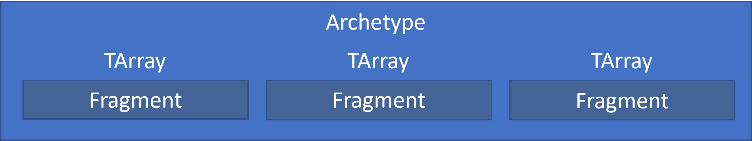
Notes:
Archetypes are stored in chunks

Slide 28
Notes:
Archetypes are stored in chunks

Slide 29
Processor
Entity Query
Execute
Notes:
The functionality which works on the data fragments is in the processors

Slide 30
Processor
Entity Query
Execute
Notes:
A processor has an Entity Query which is used to filter which chunks it can act on

Slide 31
Processor
Entity Query
Execute
Notes:
If the archetype configuration does not match the requirements of the entity query, it is ignored

Slide 32
Processor
Entity Query
Execute
Notes:
If the archetype config does match the entity query requirements…

Slide 33
Processor
Entity Query
Execute
Notes:
It will be processed

Slide 34
Processor
Entity Query
Execute
Notes:
Then the processor moves on to the next chunk

Slide 35
Processor
Entity Query
Execute

Slide 36
Processor
Entity Query
Execute

Slide 37
Processor
Entity Query
Execute

Slide 38
Processor
Entity Query
Execute

Slide 39
Processor
Entity Query
Execute
Notes:
This is called batch processing
It happens every frame

Slide 40
So if entities are just an abstract concept,
where do we start?

Slide 41
So if entities are just an abstract concept,
where do we start?
By creating an entity of course!

Slide 42

So if entities are just an abstract concept,
where do we start?
By creating an entity of course!

Slide 43
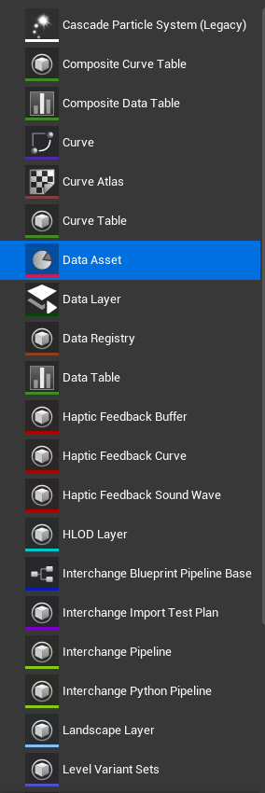
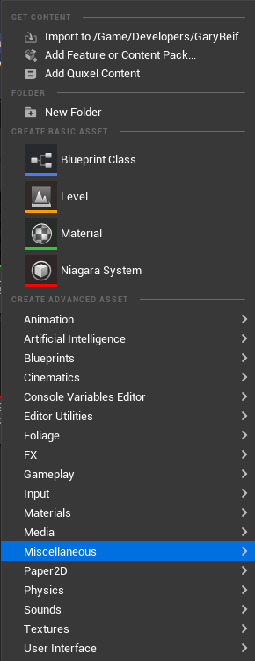
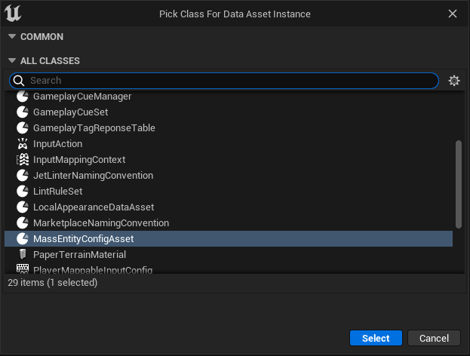
Entity Creation - Editor

Slide 44
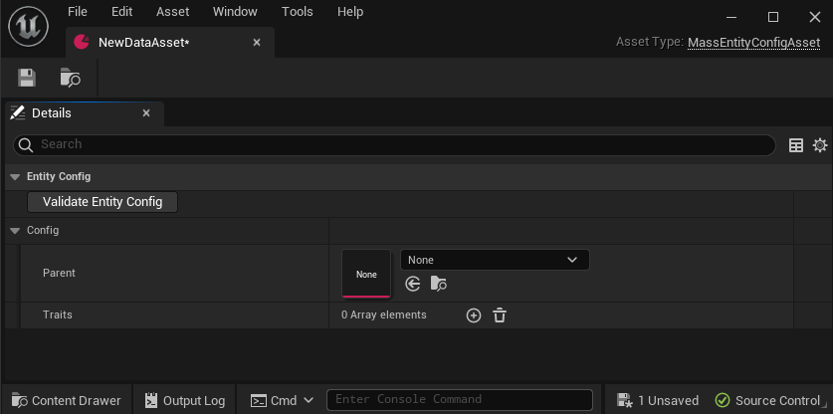
Entity Creation - Editor

Slide 45
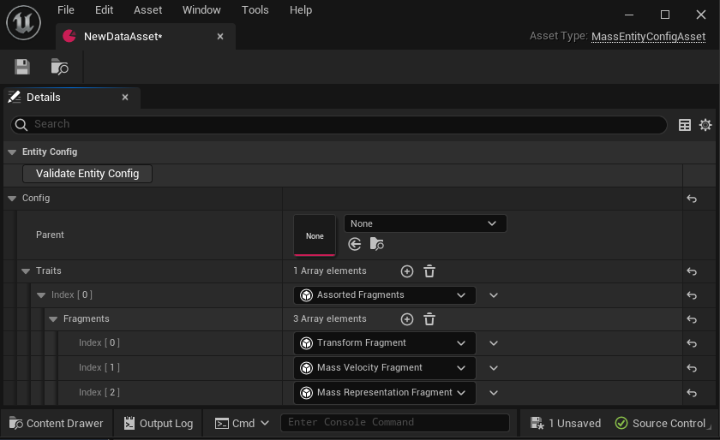
Entity Creation - Editor

Slide 46
Entity Creation - Code
Archetype
TArray
TArray
FMassFragmentBitSet
Fragment
Fragment
New Archetype
TArray
TArray
TArray
Fragment
Fragment
Fragment
Notes:
To create a new entity config without a config asset, need to create the archetype first
Can create by extending an existing archetype

Slide 47
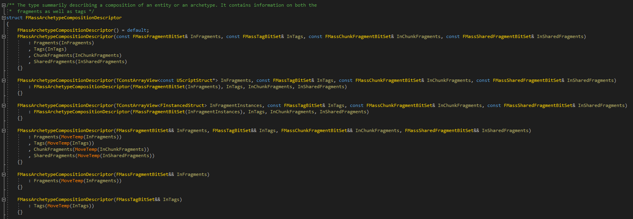
Entity Creation - Code
Notes:
Or create a new archetype from scratch by describing the composition

Slide 48

Entity Creation - Engine
Notes:
You call the CreateEntity function of EntityManager to create an entity.
This can even create a new archetype if necessary.

Slide 49
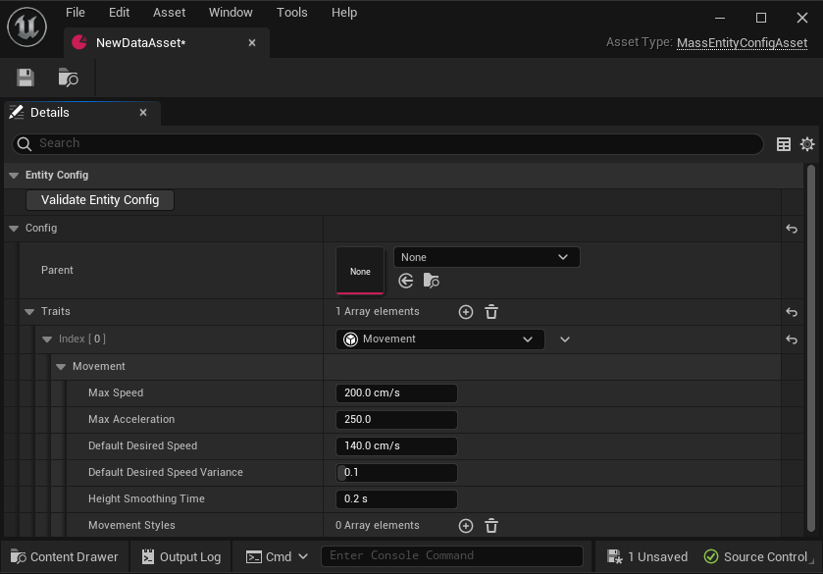
Entity Traits
Notes:
Instead of adding each fragment individually, we can use traits
Traits also allow us to create configuration data that can be shared between multiple fragments or accessed anywhere else

Slide 50
Entity Traits
BuildTemplate
Adds fragments (including shared) and tags
Require the presence of fragments (without adding them)
Specialized functionality (see translators)

Slide 51
But if entities aren’t real,
how do we access fragment data?

Slide 52
But if entities aren’t real,
how do we access fragment data?
With an entity of course!

Slide 53
But if entities aren’t real,
how do we access fragment data?
With an entity of course!

Slide 54
How to Reference an Entity
FMassEntityHandle
Lightweight
Only data is an Index and a Serial Number
Has a few utility functions
Can be used in many functions to get entity data (e.g. fragments) or perform operations on entities (add/remove tags, etc.)
Notes:
FMassEntityHandle exists while entity exists in Entity Manager
FMassEntityView is a struct view to a transient struct created for processing
Chunk index is preferred method as it will happen during normal processing flow and is therefore safest

Slide 55
How to Reference an Entity
FMassEntityHandle
Lightweight
Only data is an Index and a Serial Number
Has a few utility functions
Can be used in many functions to get entity data (e.g. fragments) or perform operations on entities (add/remove tags, etc.)
FMassEntityView
Transient (don’t pass out of scope where it was created)
More heavyweight method of representing an entity
Multiple functions for getting fragment and tag data
Notes:
FMassEntityHandle exists while entity exists in Entity Manager
FMassEntityView is a struct view to a transient struct created for processing
Chunk index is preferred method as it will happen during normal processing flow and is therefore safest

Slide 56
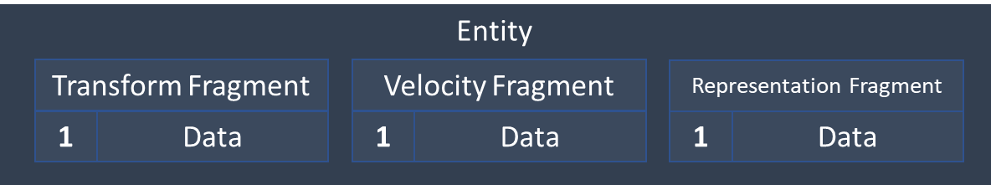
How to Reference an Entity
FMassEntityHandle
FMassEntityView
Lightweight
Only data is an Index and a Serial Number
Has a few utility functions
Can be used in many functions to get entity data (e.g. fragments) or perform operations on entities (add/remove tags, etc.)
Transient (don’t pass out of scope where it was created)
More heavyweight method of representing an entity
Multiple functions for getting fragment and tag data
Entity Index (in Chunk)
For loop from 0 to (NumEntities – 1)
Access each fragment array by this index
Notes:
FMassEntityHandle exists while entity exists in Entity Manager
FMassEntityView is a struct view to a transient struct created for processing
Chunk index is preferred method as it will happen during normal processing flow and is therefore safest

Slide 57
Entity Manager
CreateEntity / BuildEntity
CreateArchetype / GetArchetypeForEntity
Add/Remove fragment to/from entity
AddFragmentListToEntity
Add/Remove tag to/from entity
IsEntityValid / IsEntityBuilt / IsEntityActive
GetFragmentDataChecked / GetFragmentDataPtr / GetFragmentDataStruct
GetOrCreateSharedFragment
CreateExecutionContext
Defer()
TChunkedArray<FEntityData> Entities
TMap<UInt32, TArray<TSharedPtr<FMassArchetypeData>>> FragmentHashToArchetypeMap
TMap<const UScriptStruct*, TArray<TSharedPtr<FMassArchetypeData>>> FragmentTypeToArchetypeMap
TArray<FConstSharedStruct> ConstSharedFragments
TArray<FSharedStruct> SharedFragments

Slide 58
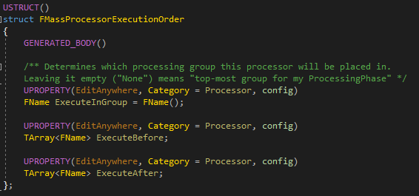
Mass Processor
bRequiresGameThreadExecution
ConfigureQueries
Execute
UMassCompositeProcessor
Automatically multithreaded based on requirements (fragments, subsystems, etc.)
Executed in phases.
Can be grouped to ensure execution order.

Slide 59
Execution Context
Created by MassExecutor each frame, for each processing phase, before processors are run.
Reference passed to FMassEntityQuery::ForEachEntityChunk, which passes it to the archetype for execution.
Provides access to resources needed during processing (entities, archetypes, etc.).
Provides FMassCommandBuffer via Defer() (thread-safe during entity query).
Command buffer flushed at the end of the processing phase.
Can create your own instance for some functionality.
Creating through FMassEntityManager::CreateExecutionContext gives access to shared command buffer.

Slide 60
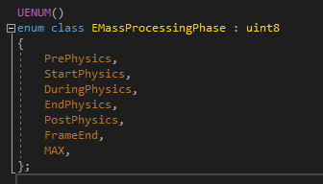
Processing Phases
UMassProcessingPhase is a wrapper for FMassProcessingPhase struct.
FMassProcessingPhase is an FTickFunction.
Parallel & single-threaded, automatically managed.
Holds an FMassCompositeProcessor containing all processors to be run in that phase.
Single execution context shared with all processors executed in this phase, this frame.
Raises FOnPhaseEvent delegate on each phase start & end.
Processors are manually assigned to a phase via configuration in editor or ini files.

Slide 61
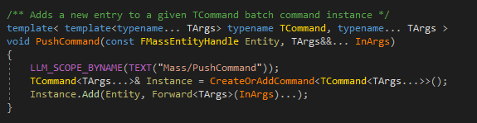
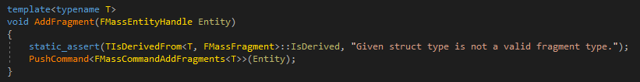
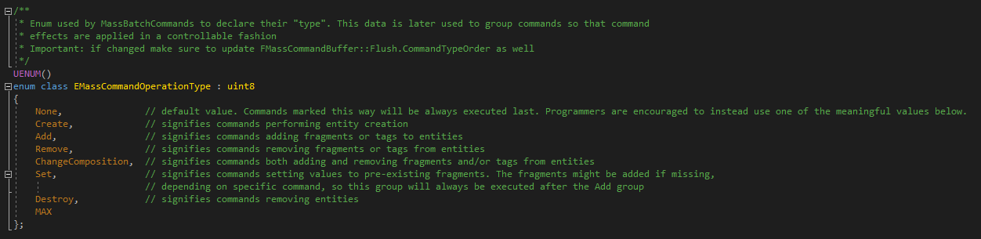
Mass Command Buffer
Used to safely manipulate archetypes/fragments/etc.
Available from many endpoints (EntityManager, Context, etc.).
Create your own custom commands or just use “PushCommand” with a lambda.
Flushed at the end of every processing phase.

Slide 62
Entity Query
Inherits from FMassFragmentRequirements and FMassSubsystemRequirements
ForEachEntityChunk
GetArchetypes
HasMatchingEntities / GetNumMatchingEntities
SetChunkFilter / ClearChunkFilter / HasChunkFilter
Example processor constructor that initializes the entity query:
FMassFragmentRequirements
FMassSubsystemRequirements
AddRequirement
AddTagRequirement
AddChunkRequirement
AddSharedRequirement (also const version)
AddSubsystemRequirement (subsystem must implement TMassExternalSubsystemTraits)

Slide 63
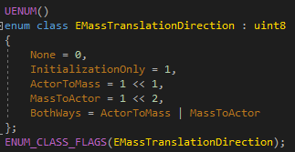
Translator Processor
Child of UMassProcessor
Used to transfer data between fragments and UObjects.
Initial step required in trait BuildTemplate function to collect UObject references and initialize fragment data from them.

Slide 64
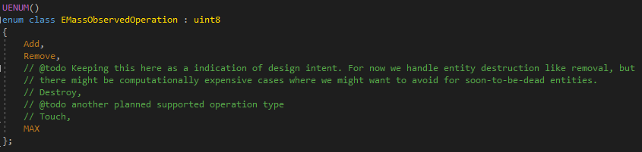
Observer Processor
Child of UMassProcessor
One per fragment type
Runs when fragment is either added or removed (specified in processor constructor)
Used to initialize fragments or update subsystems

Slide 65
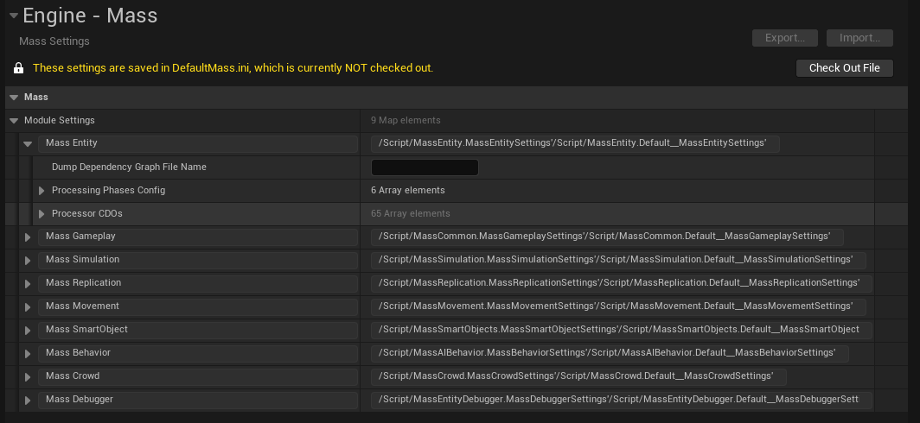
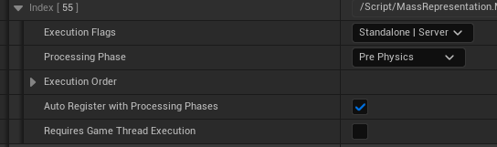
Representation & Visualization Processors
Used to visually represent Mass entities in game world
UActors or instanced static meshes
No restrictions on UActors, so they can have their own logic
Use translator processors to ensure entity and actor stay in sync
LOD based
High/Medium/Low/Off
Configure by count and distance from player
Debug vs crowd vs base
Non-crowd visualization processors may be disabled by default
Enable in Project Settings->Engine->Mass->Module Settings->Mass Entity->Processor CDOs
Or edit DefaultMass.ini

Slide 66
State Tree Processor
FMassStateTreeEvaluatorBase
FMassStateTreeTaskBase
Wrappers for state tree evaluator/task
Uses FStateTreeConditionBase (no wrapper)
Task Tick: Mass Signals
Hard-coded…

Slide 67
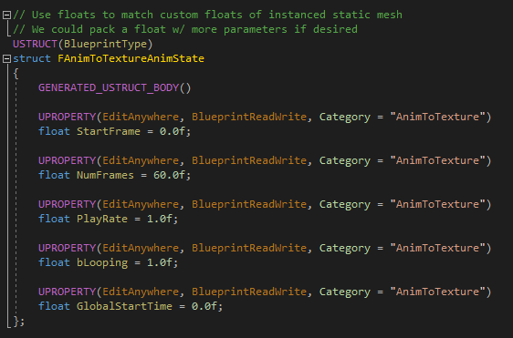
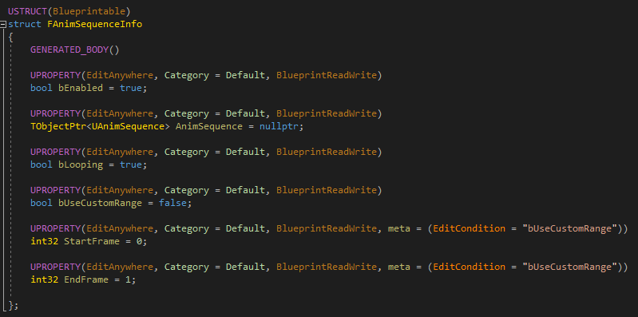
Animation Processor
AnimToTexture Plugin
Powerful tool for syncing data between skeletal animations and vertex animations
Vertex animation data passed to instanced static mesh material via Custom Primitive Data channels.
Implemented in City Sample project.
Lightweight montage instance.
Root motion.

Slide 68
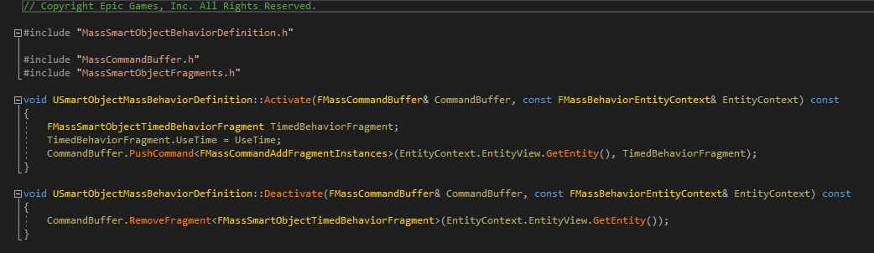
Smart Object Processor
FMassSmartObjectUserFragment
How entity interacts with smart object
USmartObjectMassBehaviorDefinition
Activate
Deactivate
Manipulate entity through the command buffer.

Slide 69
Navigation & Move Processors
Avoidance
Neighbor-driven forces
Steering
Force toward goal
Orientation
Rotation toward facing target
FMassForceFragment
FMassVelocityFragment
FMassTransformFragment

Slide 70
Mass Replication
Client Bubble
Custom structs for data replication
Custom data handler
Entity data stored in array property of replicated struct on custom AActor

Slide 71
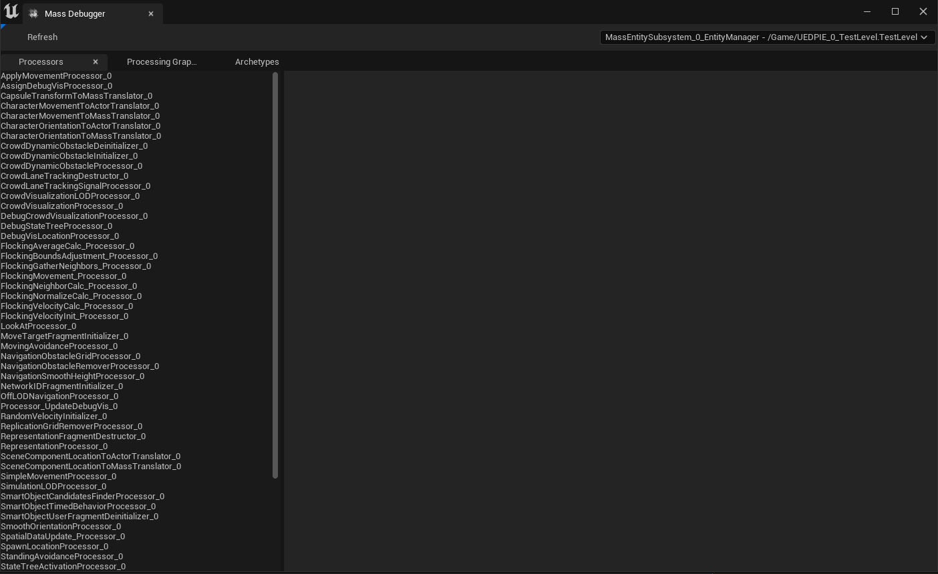
Mass Entity Debugger

Slide 72
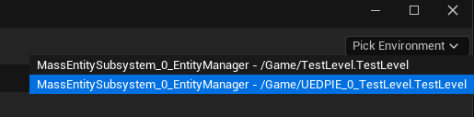
Mass Entity Debugger

Slide 73
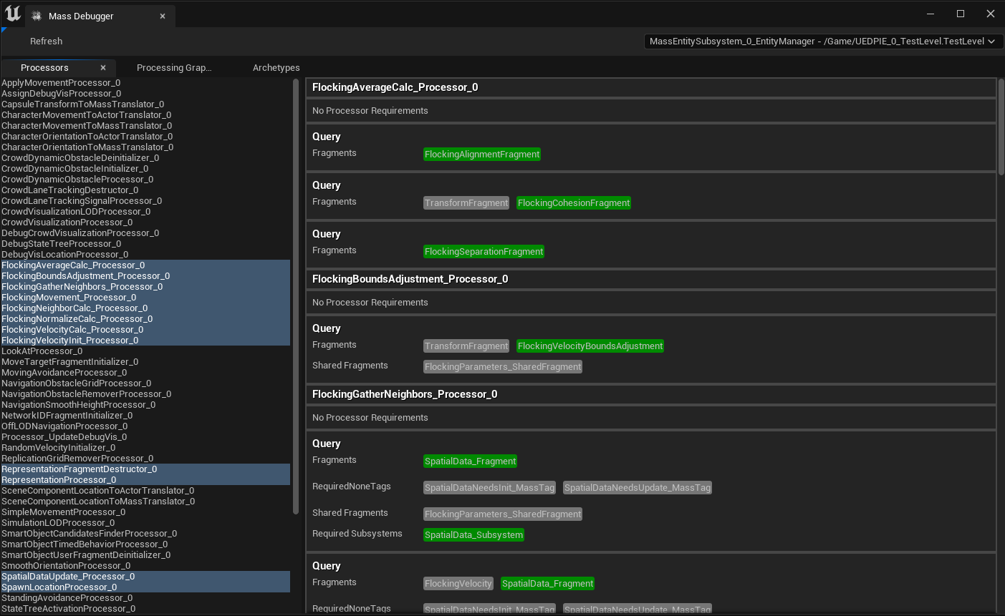
Mass Entity Debugger

Slide 74
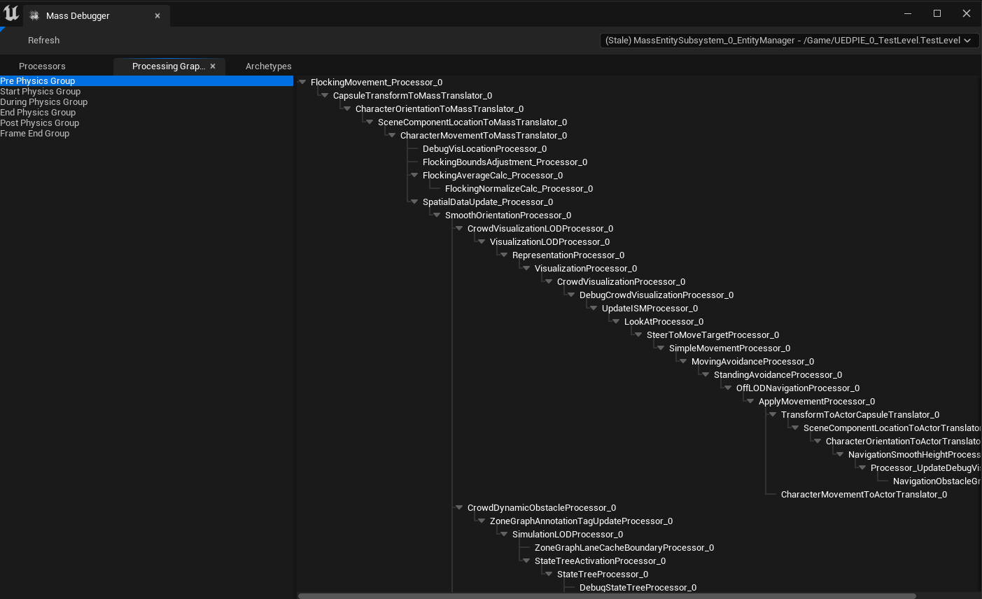
Mass Entity Debugger

Slide 75
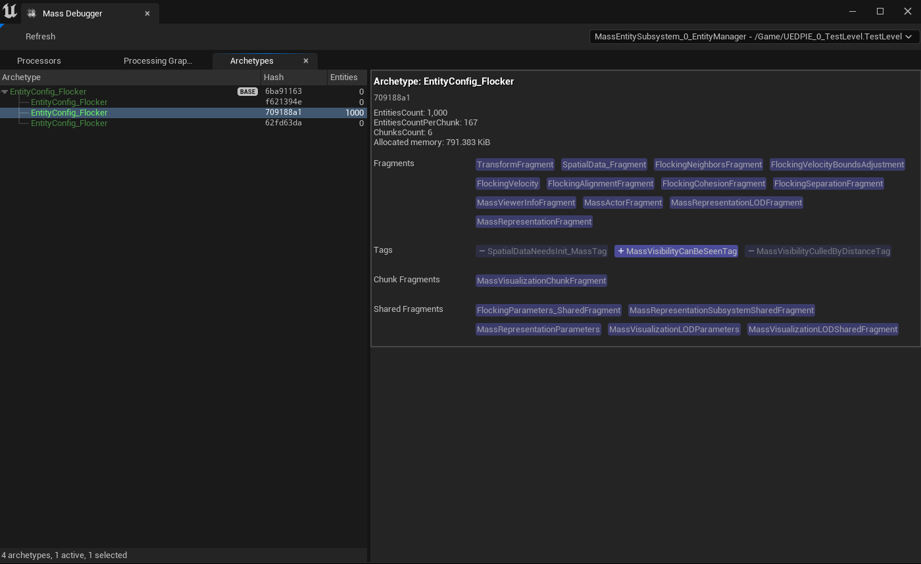
Mass Entity Debugger

